Slide 1




OVERVIEW OF THE ELECTRONIC DISPENSING TOOL (EDT)
[presenter’s name]
Senior Technical Advisor
MSH/SIAPS

Slide 2
Background: EDT Working Definitions
Main sites:
All 35 public hospitals are main ART sites.
The other 15 main ART sites include 8 health centres & 7 clinics which provide ART and
(1) have full time (permanent) clinical team i.e. doctor, pharmacy & nursing staff at the site; or
(2) have the EDT and send a monthly ART report to Division: Pharmaceutical Services
Outreach sites:
those that provide ART services but depend on a team (doctor (s), nurses and pharmacy staff) from the main site going routinely to the sites to provide these services
6 outreach sites have an EDT computer on site
Notes:
Health Centres: Aranos, Nkurenkuru, Katutura, Odibo, Ongha, Okalongo, Ondangwa, Ongwediva
Clinics: Khomasdal, Okuryangava, Robert Mugabe
Outreach sites with EDT: Rosh Pinah, Groot Aub, Dordabis, Otjomuise, Onesi, Oshivelo

Slide 3
Background: EDT Working Definitions (2)
IMAI sites:
are those that provide ARVs to patients on a named patient basis. These sites do not initiate ART but provide medicines to stable patients only (this is now changing with the task shifting initiative)
Outreach service points:
ART outreaches are sometimes done at places that are not health facilities e.g. community halls, designated places at a community

Slide 4
The Electronic Dispensing Tool (EDT)
Developed by the USAID –funded RPM Plus program in 2006 to meet the need for a practical data capturing and effective information management system for ARV medicines and patient data in the pharmacy
Enhancements were made to customize the EDT for the Namibia setting: features added included ability to print labels in local languages, creation of new reports and enhancement of reports available from the system and creation of an adherence module
Currently installed at 50 sites in Namibia (all the main sites and some outreach sites)

Slide 5
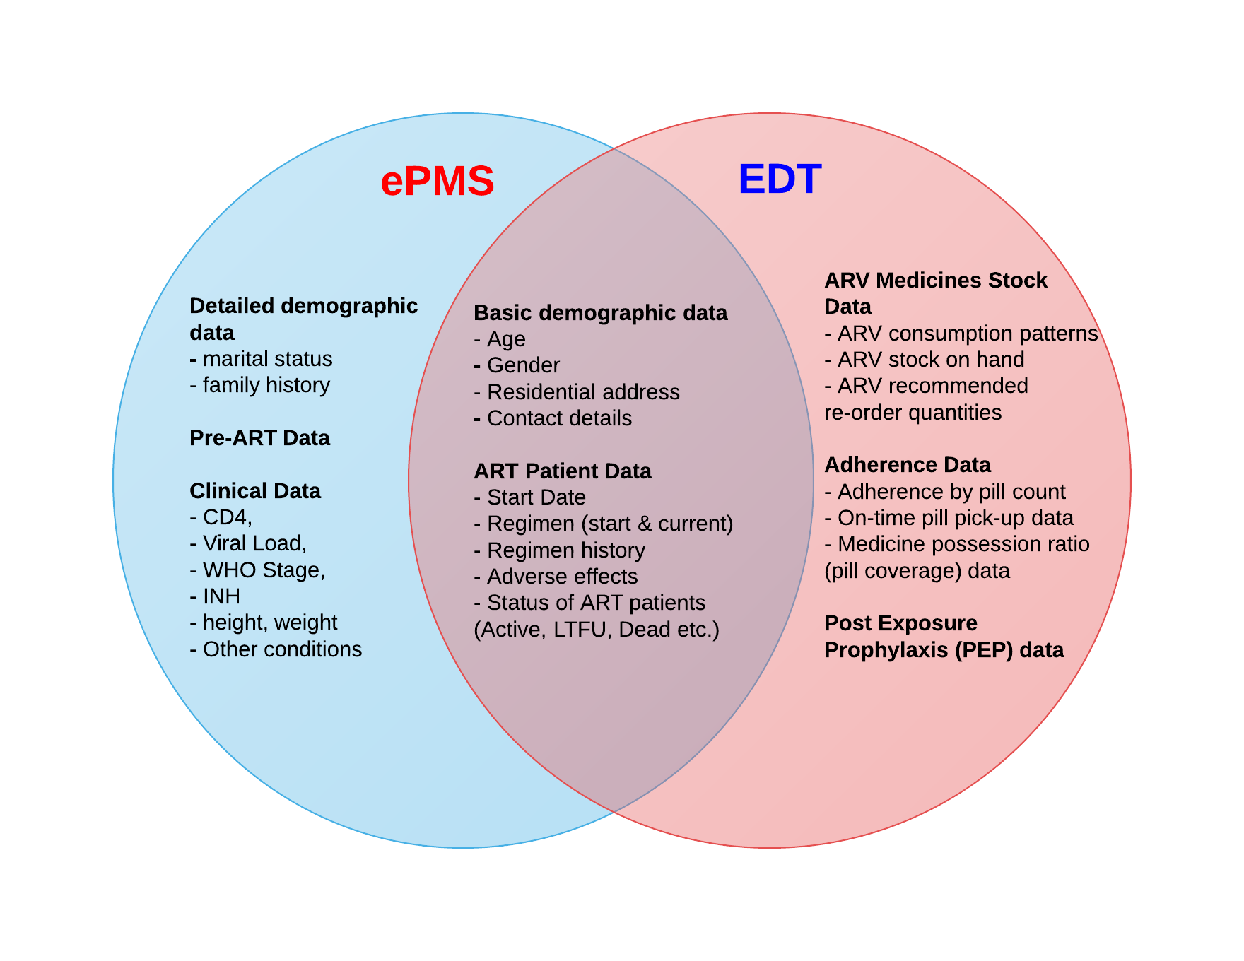
Data in the EDT and ePMS systems at facility-level

Slide 6
EDT: Features
Database is based on Microsoft SQL server
The EDT comprises 2 modules: a dispensing module and a reporting module
The dispensing module has the following:
PATIENTS section; STOCK section; EDT MOBILE section
The adherence module is in-built and utilises dispensing data to calculate a patient’s adherence based on pill count
The reporting module is able to produce facility reports for a number of parameters
Plans underway to program EDT to send automatic reminders to patients based on desired criteria as well as to receive & store pre-defined feedback from patients

Slide 7
Uses of the EDT
Patient Management at Main Site using the EDT
Entering patients on ART from other sites
Stock Management at Main Site using the EDT
Main site ART processes
Patient Management at Referral Site
using the EDT Mobile
ART Reporting and Data Quality using EDT reports
Completing the Monthly ART Reporting Template at main site
Stopping patient management on the EDT
Updating patient data
Recording stock take details
Referral site ART Process flow
Dispensing to patients
Main site ART processes
Recruitment of new patients initiating ART
Reversing a transaction
Managing patient appointments
Receiving and Issuing of stock from the EDT
Quantification of ARVs
Preparing stock for referral site
Referral site ART Processes
Preparing for referral site visit
Dispensing at referral site
ART recruitment at IMAI site
Facility, regional, and national level
Using predfined EDT reports
Improving EDT Data qaulity
ART Data abstraction, validation and use
Monitoring patient adherence to ART

Slide 8
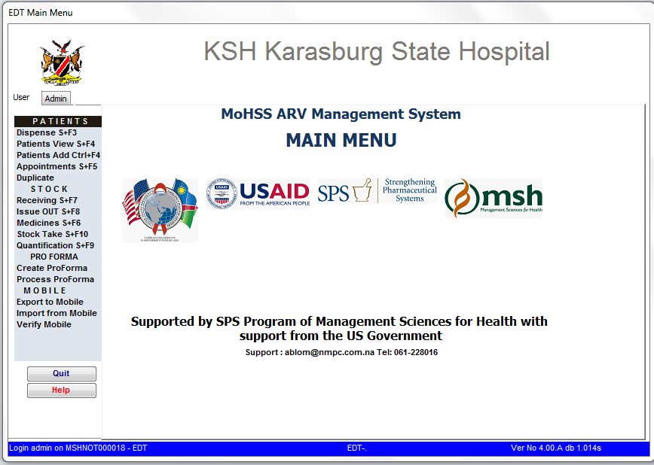
EDT Dispensing Module

Slide 9
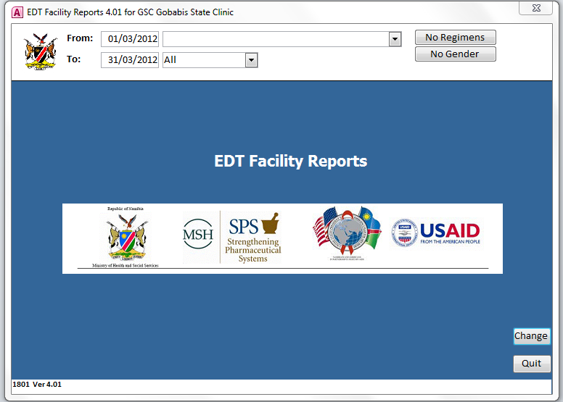
EDT Reporting Module

Slide 10
EDT Mobile: Features
An EDT mobile version is available for use by pharmacy staff participating in ART outreach services
The software is in a handheld scanner that is battery powered and is suitable for facilities that have no electricity and/ or limited space.
Dispensing is done using the scanner at the outreach site and, when pharmacy staff return to the main site, this data is uploaded onto the main site’s EDT PC via a Bluetooth or serial connection
To address challenges of handling pharmacy data at IMAI sites with rising patient populations, the EDT mobile is being rolled out for use by nursing staff at IMAI sites in Zambezi and Kavango regions

Slide 11
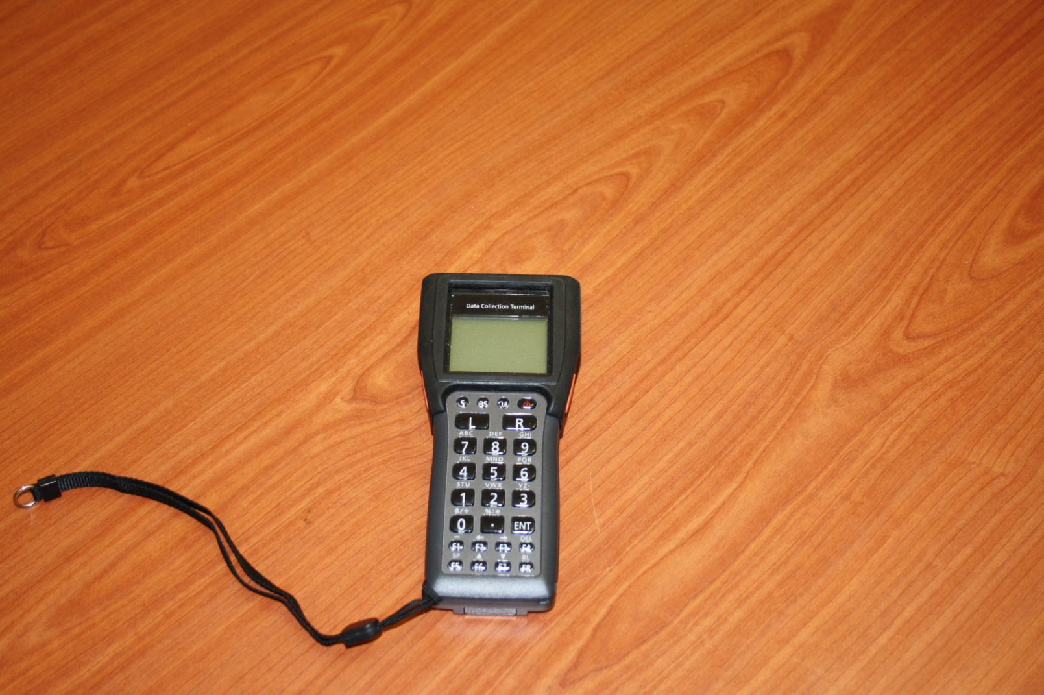
EDT Mobile

Slide 12
EDT: Reports/ Data Available
Patient data: dispensing history, history of status changes, adherence history; appointment list for a given day
Patient summary reports by status: Active, Lost, LTFU, Transferred Out, Transferred In, Stopped by Physician and Deceased
Adherence-related reports: On-time pick of ARVs, adherence by pill count, mean facility adherence
ARV Stock data: Stock status at any given time, ARVs consumption for a given period

Slide 13
EDT: Reports/ Data Available
HIV DR EWI Reports
% of patients retained on 1st line therapy at 12 months for a selected cohort
% of patients LTFU at 12 months for a selected cohort
% of patients started on an appropriate 1st line regimen
% of patients exhibiting >75% adherence based on pill count
% of patients picking up their ARVs on time for a selected cohort

Slide 14
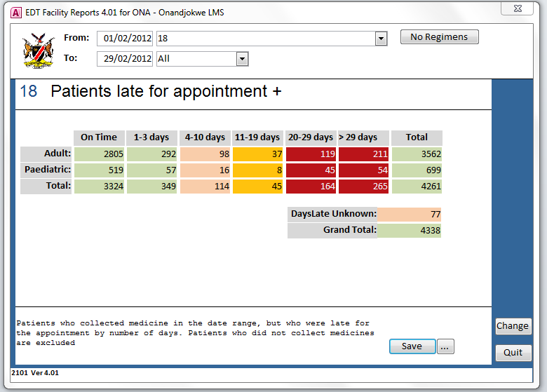
Example of an EDT Report

Slide 15
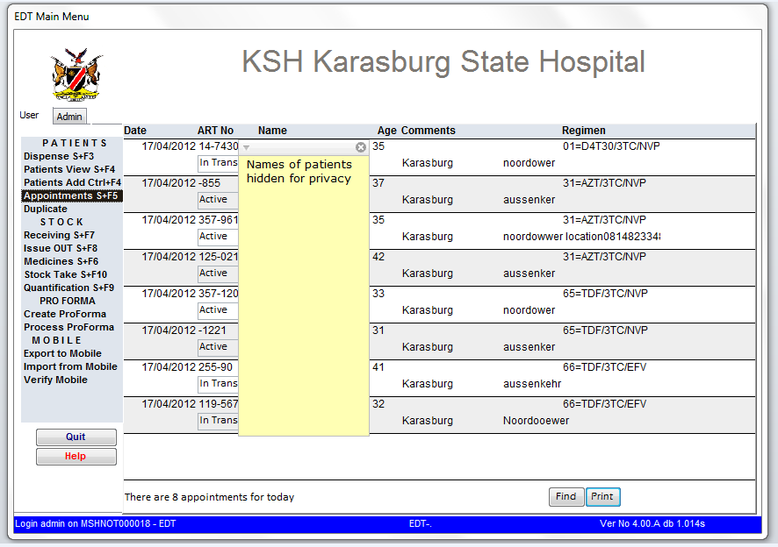
Patients Appointment List for a given date

Slide 16
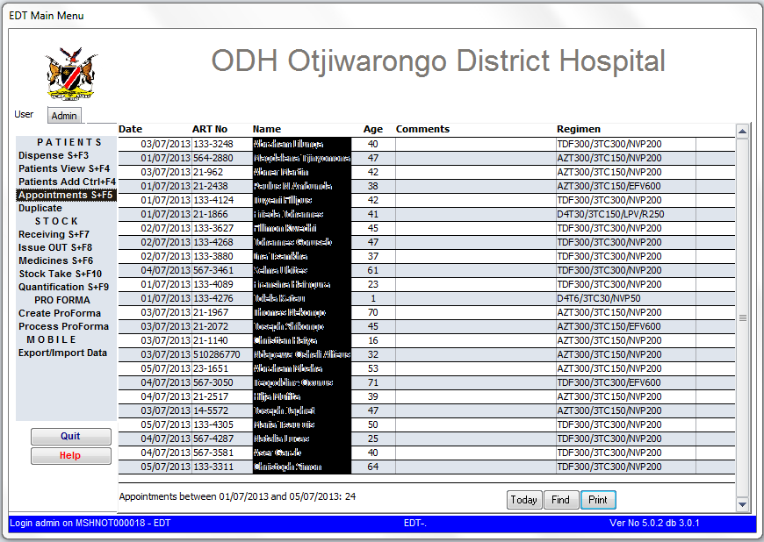
Patients who missed their appointment for a given period (one week)

Slide 17
The National Database (NDB)
Data from the all the facility EDTs is transmitted every month (or when required) to a national pharmacy database (NDB) situated at Division: Pharmaceutical Services at MoHSS HQ
Data is transmitted via the Mobile Telecommunications (MTC’s) 3G network
The MTC connection is also used to push EDT software anti-virus updates from Windhoek to the facility EDTs
A remote desktop support (RDS) feature enables the Information and Systems Administrator (ISA) in Windhoek to log into any EDT computer in the country at the request of the facility EDT user and troubleshoot any software issues

Slide 18
Use of EDT Data
The ART logistics pharmacist receives monthly ART reports from all the ART sites and aggregates and analyses this data using Excel-based templates.
A quarterly ART feedback report is compiled & disseminated to relevant stakeholders- facility and regional staff, ART program officers, partners etc.
Ad hoc analyses are also done on the NDB data and results of these analyses are discussed by the MoHSS’s Technical Advisory Committee (TAC) on HIV/ AIDS

Slide 19
Use of EDT Data- examples
Adherence measuring and monitoring using standardised indicators that are based on pharmacy refill data e.g. on-time-pill-pick-up, pill coverage (medication-possession ration) and adherence based on pill count data
EDT data has been (and continues to be) used to provide data for the WHO HIV Drug Resistance Early Warning Indicators. This data has been published in international journals
Operational Research: e.g study on AZT-related anaemia in Namibia
ARV stocks consumption and stock status data is used by the MoHSS to conduct forecasting and quantification exercises

Slide 20
Sustainability Measures
In order to integrate the tool in the MoHSS for sustainability- Systems Administrator and ART logistics pharmacist are based at MoHSS
All EDT-related equipment handed over to MoHSS to be included in the regional directorates’ inventory
Continuous facility support necessary to minimise EDT downtime at facility level and thus ensure continuous availability of accurate and reliable patient and stock data
Introduction of basic pre-service EDT training (for NHTC’s pharmacy assistant course and UNAM’s B.Pharm course) to facilitate continuous training and mitigate high pharmacy staff turn over in Namibia

Slide 21
Thank You

